Slide 1
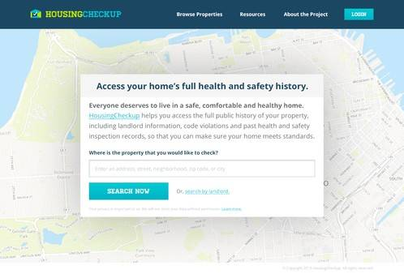
Housing Check-Up: Leveraging Open Inspection Data for Healthy Homes
Rajiv Bhatia

Slide 2
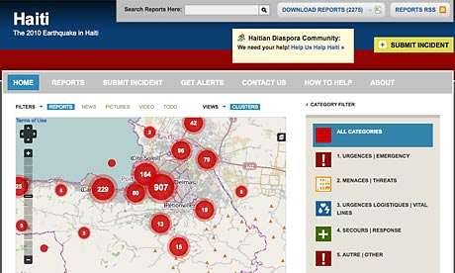
Collaborations among civil society organizations, open-data and government transparency advocates, and civic entrepreneurs are demonstrating new ways to increase citizen information and engagement to address unhealthy and inequitable environmental conditions

Slide 3
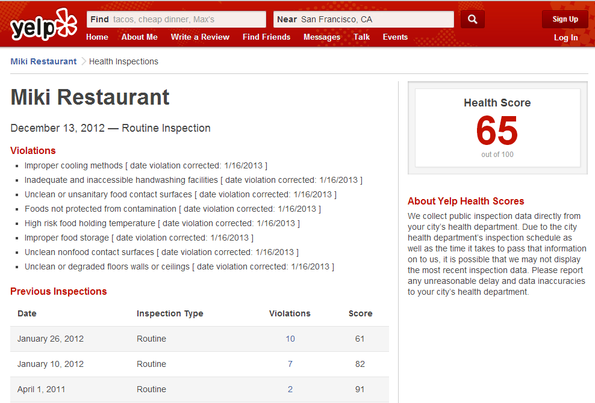
Social media can expose government data on business compliance with environmental regulations. For example, YELP recently integrated restaurant health inspection data into their crowd-sourced restaurant reviews. An open data standard for restaurant inspection data reduced the cost of information for YELP.

Slide 4

The House Facts© open data standard provides a uniform format for reporting machine-readable data on the governmental regulation of health and safety in residential housing. The City of San Francisco, Code For America, NCHH, and others developed the House Facts standard to facilitate the publication of housing inspection data in the same format nationally.

Slide 5
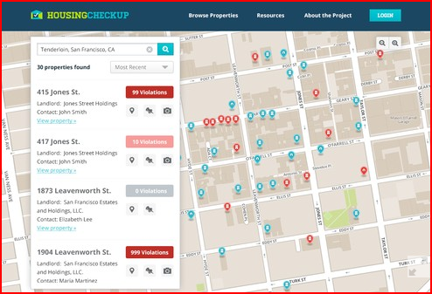
Exposing housing inspection data and violation histories has several potential uses: -motivating landlords to comply with the standards -holding government regulatory agencies accountable -providing disclosure for tenants -helping advocates fight for tenants

Slide 6
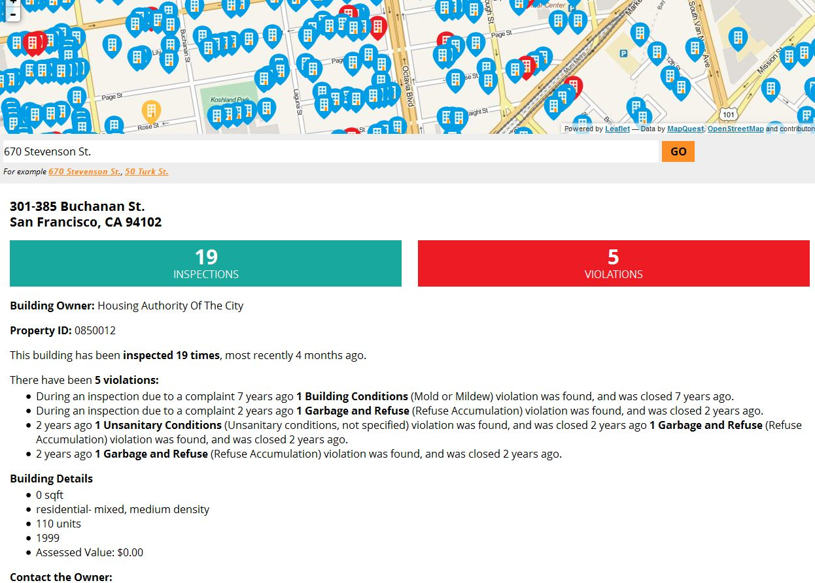
Prototypes for consumer-facing applications based on the House Facts standard are already under construction. Greater user demand for inspection data and more cities publishing data serves as an incentive for application developers.

Slide 7
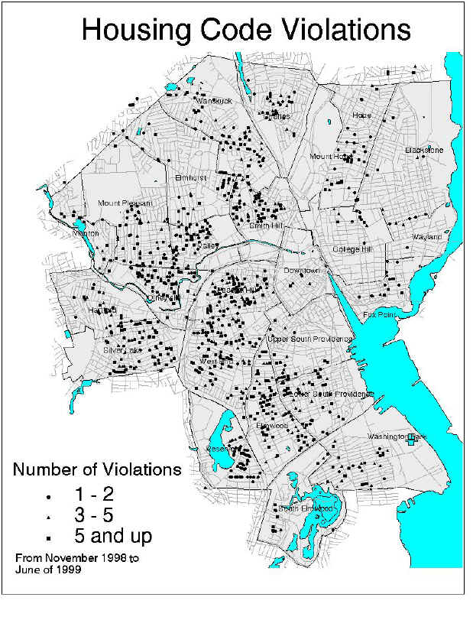
Maps and other visualizations of housing violation data can expose gaps and opportunities in local housing regulation and to provide evidence to proponents for healthy housing to pursue policy changes. For example, tenants groups could argue that a disproportionate concentration of violations in some neighborhoods demands more targeted or risk-based inspections.

Slide 8
Enabling Factors and Obstacles for Open Regulatory Data
⬆ External: tenant demand; open-data champions; community-governmental partnerships, housing and tenant advocacy capacity ⬆ Internal: Open data culture; performance management culture; commitment to community needs; pro-active or risk-based inspections
⬇ External: anti-regulatory culture; organized property-owner interest groups; lack of organized housing and tenant advocacy ⬇ Internal: Lack of machine data; limited regulator commitment to transparency

